Slide 1
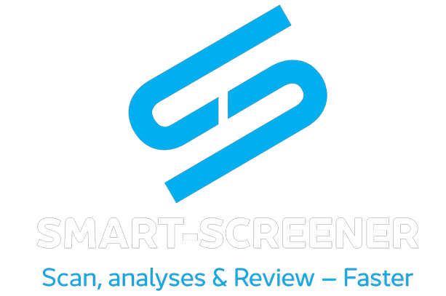
SeedSmart
A powerful yet simple analytics tool for VC & PE Funds to scan, analyze, and review Ventures!

Slide 2





Problem
Analysts scan through 1000’s of applications to invest a few
Analysts spend 120-150 hours every month in screening and Due Diligence
Process Bound
Screening is a manual process which is often laborious and time-consuming
Time Bound
If VCs don’t act quickly, they can lose up on opportunities

Slide 3






Solution
AI - enabled app that can streamline the screening process quickly
Summary with clear metrics on each startup’s likelihood of success
Faster, Efficient, and accurate, screening
Compare with million data points from start-ups in similar space to help VCs make informed decision
Detailed due diligence reports to provide details on 200+ aspect of the startup
E.g., Social-Media Presence
App/web score on a scale of 100
UI/UX experience
Product reviews
Scalable Due-Diligence process to screen 100s of companies and pick winners

Slide 4

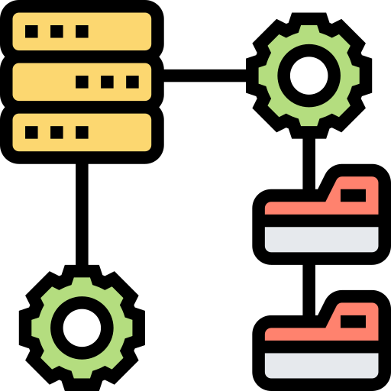




Product
Webapp marketplace to onboard VCs and startups.
Each startup will have an overview on different aspects and then a detailed insights into its functioning
A curated list of VCs will be provided to the startups and list of startups to the VCs.
Integration with Zapier, Pitchbook and dozen other apps
Generate detailed reports in less than a minute
ML model to identify potential synergies

Slide 5



How it works
Start-up opportunities are forwarded to the VCs in our network along with the reports generated by the SeedSmart Bot
Based on our reports, the VCs would accept/pass on the investment opportunity
Our app will collect the information, process it and create a principle component analysis to generate a solo report highlighting potential risks and other parameters crucial to the VCs.
Startup founder will create an account / fill out a form.

Slide 6



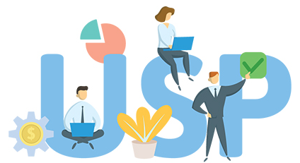
Advantage SeedSmart
Our ML models to analyze unstructured data on startups
Recommendation engine for startup → VC and VC → startup
Data of other startups from various databases that serves as benchmark
Analyze the VC model Investment thesis, and the fit with the VC

Slide 7



ML Models vs GPT4
01
ML models compare startups in the same industry, considering aspects like valuation and associated risks.
03
GPT4 for generating reports.
Proprietary ML models to analyze each startup.
02

Slide 8
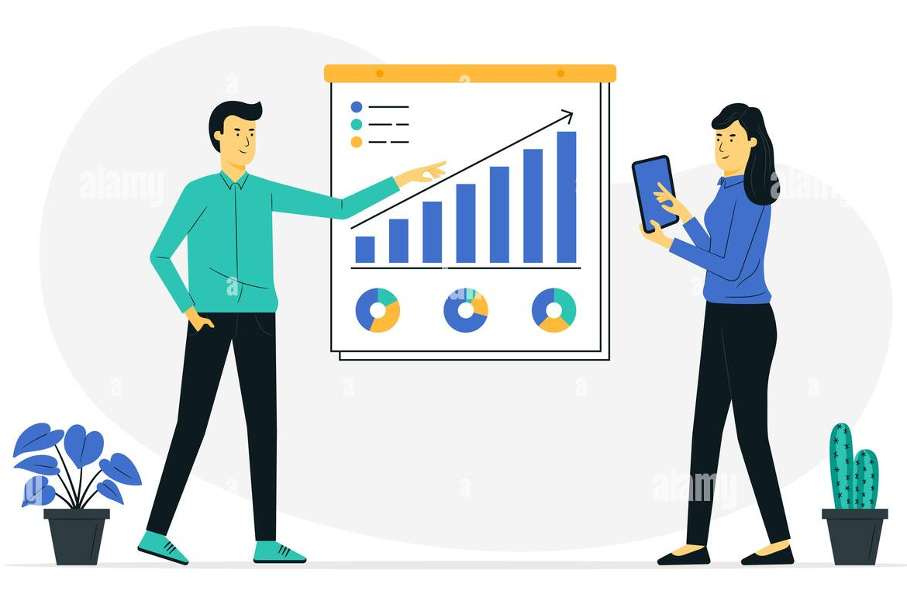
Business model
3 Pricing models
01
Free model - Browsing features for startups and VCs for discovery
Tier 1 - Personalized reports for VCs for every startup they vet through us
02
Tier 2 - VCs get reports on each startup listed on our platform. These reports are solo reports (Tier 1 reports), and also takes into consideration data points of other startups listed on our platform.
03

Slide 9

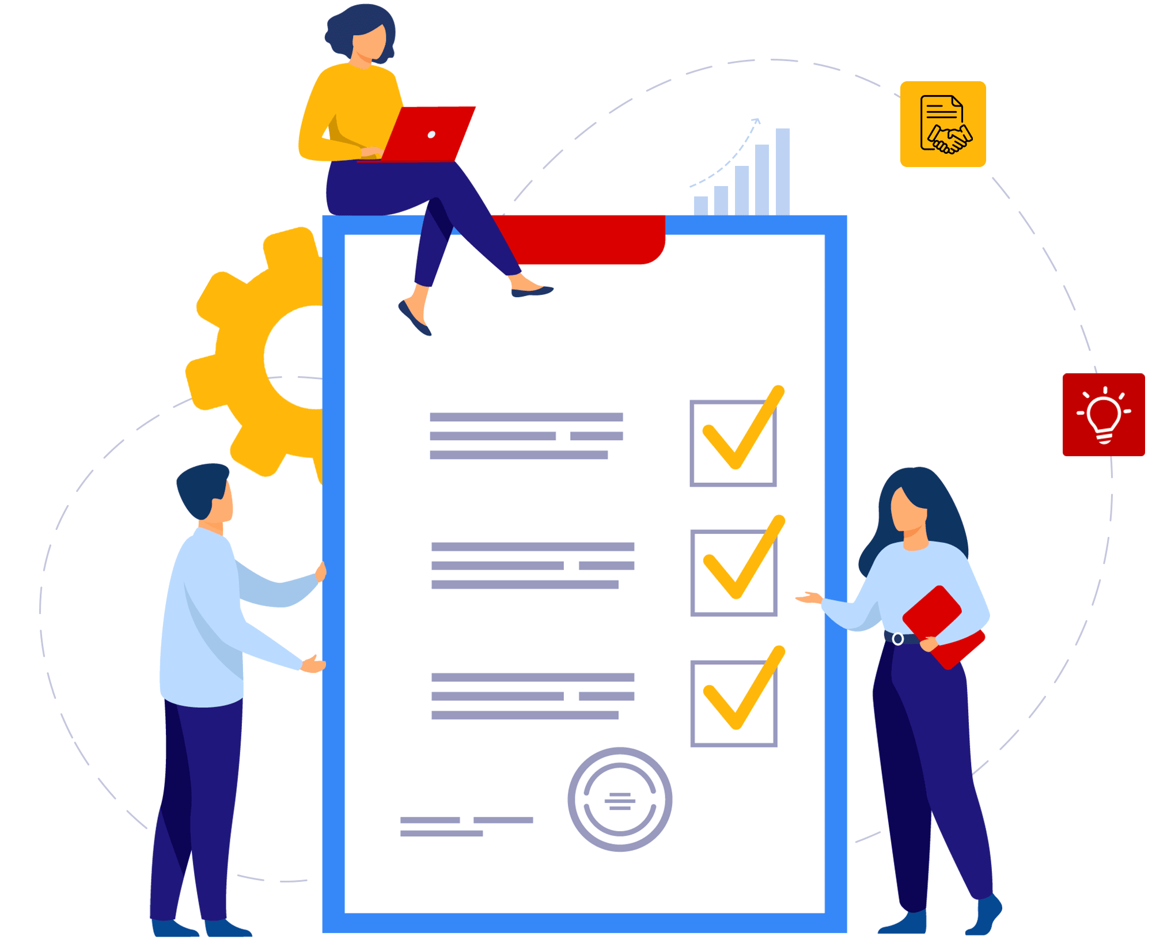


Initial Go to Market
01
02
03
04
Development Phase 1: Creating a solo report with the details provided by the startup founders. Using GPT4 and third party models to create solo reports.
Analyzing data provided and creating an accepted due diligence reports with clear formatting.
Targeting seed round VCs targeting early stage startups.
Getting the feedback, to add more features.

Slide 10



KPIs or Roadmap ahead
12 months: Recommendation engine. Ability to screen every startup with our ML models.
KPIs to track:
Number of VCs using our app
Number of startups using our app
ROI of VC invested startups curated by us (Our success metric)
6 months:
ML models to analyze more data sets.
3 months:
GPT4 enabled due diligence reports

Slide 11


Team
Ishan Gupta
Head of Product & Technology
7+ years in engineering and product management
Ex-Servify
Babson Alum (MBA)
NIT Alum (Computer Science and Engineering)
Pratish Patwardhan
Head of Business Development and Growth
8+ years in business development
Co-founder, Casten.io
Co-Founder, Powernext
Babson Alum (MBA)

Slide 12
Thank You

